Slide 1
WANTED: A CLEAN-SHAVEN SIKH
Why in matrimonial columns?

Slide 2

why do Sikhs advertise, “Wanted: A Clean-shaven Sikh” in matrimonial columns?
Keeping uncut hair is an essential requirement for a Sikh.
Then why do Sikhs advertise, “Wanted: A Clean-shaven Sikh” in matrimonial columns?
This is a very common question asked at Sikh youth camps.

Slide 3
The Question
A trainee asked a simple question, “Is it OK if a Sikh cuts his hair?”
My quick response was, “Nahin (No). Hair is the identity of a Sikh.”
“Then why do people advertise: Wanted Match for a Clean-shaven Sikh”
“Anyway what has long hair to do with the faith of a person?
One can be honest, truthful, and religious without keeping long hair.”

Slide 4
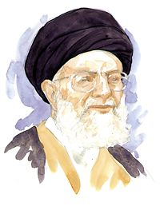
Search for the Answer:
A bearded European with long hanging hair passed by us.
I asked the youth, “Is he a Sikh?”
The answer was quick and firm “No” from the whole group.
I continued, “You mean that just keeping long hair does not make a person Sikh. Probably, this is your argument.”
“If keeping long hair does not make one a Sikh, then who is a Sikh and why should a Sikh keep long hair?”.

Slide 5
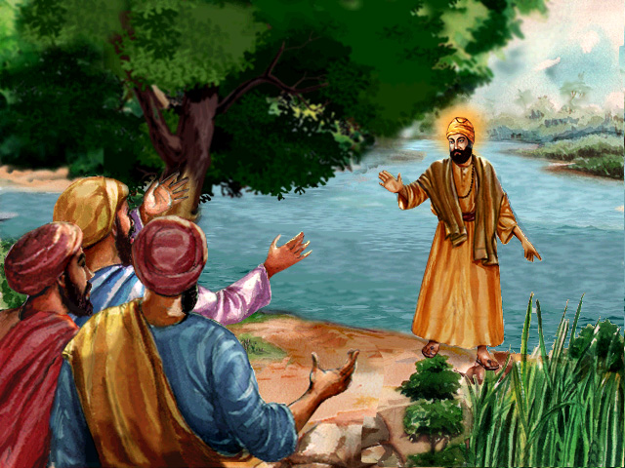
He implied that God does not judge us as Hindus, Muslims or of any other denomination.
Before Him, we all are simple human beings and equal.
The Sikh faith was founded when Guru Nanak, after coming out of the river, told the people, “Na koi Hindu, na koi Musalman.”

Slide 6
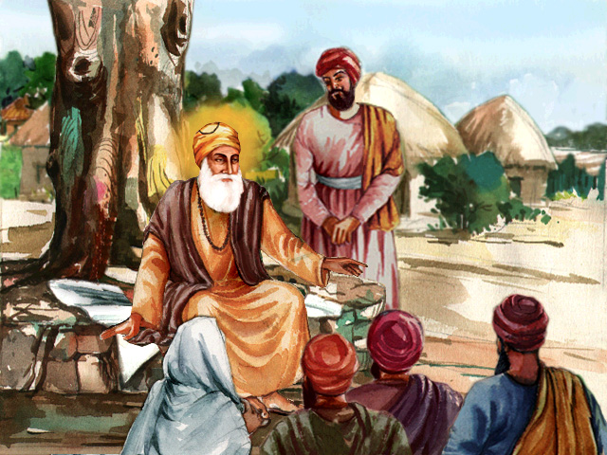
The faith
The word ‘sikh’ is a common noun and it means a disciple, a follower. Nanak, having revealed a new philosophy, became popular as a guru.
The perception regarding the word 'Sikh', a member of the new community which exists today, had not developed then
The people, Hindu or Muslim, high caste or low caste, male or female, who accepted his teaching and lived accordingly, were called Nanak’s sikhs

Slide 7
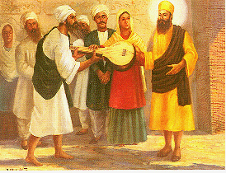
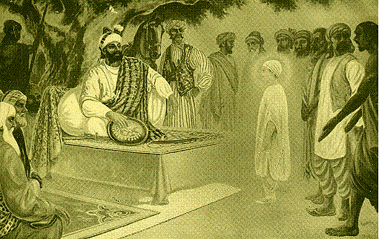
sikh
. A sikh (follower of the guru), continued to be considered a member of his original community.
Bhai Mardana and Rai Bular were Muslims; Baba Budha was a Hindu, and Bhai Lalo was a low caste, but they were all disciples, sikhs, of the guru.
The folk saying: “Nanak Shah Fakir, Hindu ka Guru, Musalman ka Pir.” became popular wherever he went.
Both communities joined the congregation to listen to guru Nanak.
Bhai Mardana
Rai Bular

Slide 8
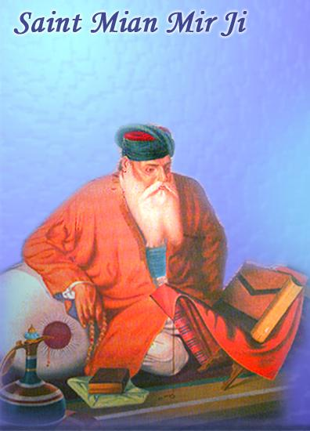
‘Guru’
Later the title ‘Guru’ was used specifically for Guru Nanak and his successors.
A Hindu raja of Kangra became a sikh, a disciple of Guru Amar Das, and supplied timber to build the town of Goindwal.
Mian Mir, a Muslim holy man, was a sikh of Guru Arjan Dev. Painda Khan, a general of Guru Hargobind, was a Muslim.
Saint Mian Mir

Slide 9
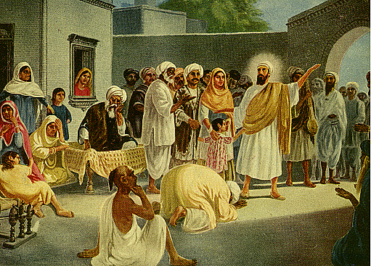
It may be mentioned here that some Hindus, particularly holy persons, already kept their hair long and sported turbans, even before Guru Nanak was born.
Muslims had beards and wore turbans in their own style
As Guru Nanak kept uncut hair, his disciples, the sikhs whether Hindus or Muslims, also started keeping long hair and wearing turbans as their identity.

Slide 10
In the Rajasthan archives, a reference to the visit of Guru Nanak Dev states, “Guru Nanak associated with all people without any discrimination but did not approve those who used razors (shaved their beards or cut their hair).”
Guru Nanak did not introduce the custom of keeping long hair and wearing turbans; this was a part of the culture all over the world before the time of Guru Nanak.
Europeans also wore turbans, and this is mentioned in the Bible as a religious requirement while praying

Slide 11
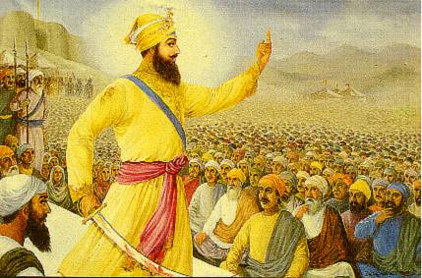
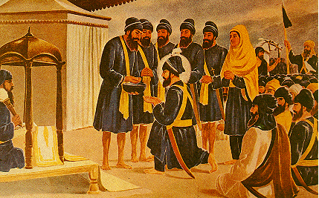
The Sikhs, a new community
To be a Sikh, a member of the Panth, all sikhs had to take amrit, wear the 5K uniform, adopt a new surname (Singh for male, Kaur for female), and agree to follow a prescribed code of conduct, the Khalsa Rahit.
In every faith, members are required to follow a specified code of conduct. The same was the case for the members of the Panth.
In 1699, Guru Gobind Singh founded a new order called the Khalsa Panth, which came to be known as the Sikh Panth or more often, simply the Sikhs (with capital ‘S’).

Slide 12
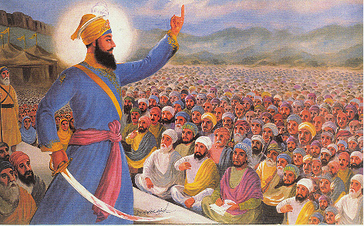
Not all sikhs, believers in the gurmat philosophy, became Sikhs, members of the Panth.
According to the intelligence reporter of the Mughal court who was deputed to cover the 1699 Vaisakhi function, about 20,000 sikhs (the numbers differ with different historians) joined the Khalsa Panth and became Sikhs, the members of the new community.
1699 Vaisakhi function, about 20,000 sikhs joined the Khalsa Panth and became Sikhs, the members of the new community.

Slide 13
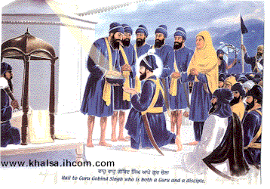
Thus, there were three distinct communities, the Hindus, the Muslims, and the Sikhs.
The first five amritdhari Sikhs were known as the Panj Pyaras, and the Guruship was passed on to them. They were to be guided by the eternal Guru, Guru Granth Sahib.
The first five amritdhari Sikhs were known as the Panj Pyaras, and the Guruship was passed on to them.

Slide 14
shardhaloos
Deciding not to join the Khalsa Panth did not mean the sikhs, the disciples, were no longer followers of the Sikh faith, an impression that some Sikhs mistakenly express about them today.
They were welcome to take further time before formally joining the Panth.
They were mentioned as sehajdharis; now, they are better known as shardhaloos, believers of the Sikh faith.
Being disciples of the Guru and followers of gurmat, they were well-wishers and supporters of the Guru Khalsa Panth.
They always sided with the Panth and suffered with them.

Slide 15
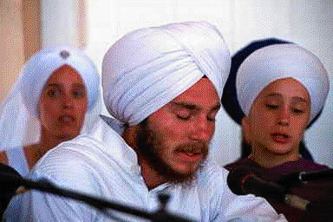
“Who is a Sikh?”
The above historical review gives us the answer to the question, “Who is a Sikh?”
A person who believes in gurmat, takes amrit, wears the 5K uniform, and follows the Rahit, becomes a Sikh.
Otherwise, a believer in gurmat is a shardhaloo, (but not a Sikh), a person on his way to taking amrit, for becoming a Sikh and thus being a full and identifiable member of the Sikh Panth.

Slide 16
'Sehjdhari Sikh' is a contradiction in terms.
'Sehjdhari Sikh' is a contradiction in terms.
Having become a Sikh, one is no more a sehjdhari (slow adopting).
In the other case, ‘sehjdhari sikh’ the word ‘sikh’ is redundant because sehjdhari means a ‘sikh’ moving on the path to be a Sikh (Singh);
there is no need for adding the word Sikh because there is no sehjdhari Muslim or sehjdhari Hindu.

Slide 17
Sehjdharis
Sehjdharis are members, well-wishers and supporters of the Sikh faith, and they have to be respected as such.
They deserve it, and it is obligatory for Sikhs to treat them as members of their community.
Example.-During the British Raj, the Indian Congress party, ordered its members to wear khadi (homespun cloth), and reject the British manufactured cloth as part of their non-cooperation movement.

Slide 18
Almost all Indians supported the Congress, but many of them did not want to express it publicly.
However, they gave full moral, social, and economic support to the party and its goal.
They were accepted as believers of the principles of the Congress philosophy.
Because these sympathizers were not visible members (did not wear khadi) and did not formally join the Congress, they could not be given any office of the party.
However, the Congress party listened to their advice, and accepted and respected them as their supporters.

Slide 19
status of the sehjdharis in the Panth.
Many people from all over the world have moved into the USA and have become resident-aliens.
They are considered Americans for all purposes, but they cannot vote because they haven’t become citizens by taking the oath of loyalty to the nation.
As a resident-alien needs to take an oath to claim membership of the nation, a sehjdhari (a resident of the Sikh Panth) needs to take amrit (oath) to be a member (citizen), of the Panth before he can participate in the decision making process (voting and becoming a member of the Sikh institutions/gurdwaras).

Slide 20
Faith and the practice of the Rahit which make one a Sikh.
That keeping long hair and wearing a turban alone does not make one a member of the Panth.
It is both the faith and the practice of the Rahit which make one a Sikh.
Those who do not believe in Guru Gobind Singh and the amrit ceremony founded by him are not members of his Khalsa Panth.
We all know that Radha Swamis, fake Nirankaris, communists, and others who do not believe in amrit, even if they keep uncut hair and wear turbans, are not Sikhs.

Slide 21
Radha Swamis, fake Nirankaris, communists
They are not even sehjdharis because they do not believe in gurmat preached by Guru Nanak.
They believe in another faith and they practice what the Guru rejected.
One cannot be a member of two faiths at the same time, for example, a Hindu and a Muslim, a Sikh and a Hindu, or a Sikh and a Radha Swami.

Slide 22
Another aspect
Another aspect of the gurmat needs to be stated before completing this discussion.
According to the Sikh faith, as already stated, it does not matter in the court of the Lord whether one is a Sikh, a sehjdhari, a Muslim, a Hindu, or someone else.
People are judged only by the deeds they do.
Being an amritdhari is the honor of being a member of the Panth, but it is not a passport to Heaven (anyway, Sikhs do not believe in places like Heaven or Hell).
Being a sehjdhari or being born in any other faith is not a disqualification for realizing Truth.
Baba Farid, Bhagat Nam Dev, and many other holy devotees whose hymns are included in the Guru Granth Sahib, are examples before us.

Slide 23
Another question
At the close of the discussion, a new question cropped up. Were the Bhagats, whose hymns are included in the Guru Granth Sahib, Sikhs or not? They did not take amrit, a requirement for the Sikhs.
To find the answer, one must understand, as mentioned in the beginning, that the words ‘guru’ and ‘sikh’ were in use much earlier than the time of Guru Nanak Dev.
They meant a teacher (guide) and a disciple, respectively. The famous scholar, Bhai Gurdas, mentions Kabir and Sen as sikhs. (Var 10 -16.)
Motivated by the honorable status obtained by Kabir, another person, Sen, a barber, also became his ‘sikh’, a disciple

Slide 24
Guru and Sikh have a specific meaning in the Sikh faith
Kabir was the first disciple, a 'sikh' of 'guru' Rama Nand (note that Rama Nand was a ‘guru’, not Guru).
There were (and are today) many ‘gurus’ and innumerable ‘sikhs’, disciples of their respective 'gurus'.
However, the word Guru and Sikh have a specific meaning in the Sikh faith. ‘Guru’ means one of the ten Gurus, besides Guru Granth Sahib and Guru Khalsa Panth;
‘Sikh’ means a member of the Sikh Panth, not just any disciple. Kabir, Nam Dev, Sen, and others were not Sikhs, members of the Khalsa Panth, which was founded by Guru Gobind Singh much later in 1699.

Slide 25
position of the sehjdharis (without turban) regarding gurdwara management.
: As only a citizen (not a resident-alien of a country can vote, and as only a person who has joined the party can be its office bearer, so only a Sikh (a citizen of the Sikh faith), not a sehjdhari (a resident of the Sikh faith) is entitled to be an office bearer of the Sikh institutions and gurdwaras.
Sehjdharis, of course, should be consulted, their views duly respected, and they should be associated in the management of the Sikh institutions.
They should not be considered as foreigners, but members of the Sikh community as explained earlier.

Slide 26
Sikh Rahit Maryada requires every devotee to be a practising Sikh to perform as a granthi, ragi, or parcharak of the Sikh faith.
Every sehjdhari should be welcome to become an office bearer but only after joining the Sikh Panth by taking amrit.
. Further, when Sikhs hear in the prayer Those who sacrificed their heads, got themselves cut joint by joint ...but lived their faith along with their uncut hair,” they would wonder, why did the Sikhs suffer so much and sacrifice their lives for living with uncut hair?

Slide 27
cutting one’s hair means giving up the membership of the Panth
.
The answer, which nobody can change, is that letting someone cut one’s hair means giving up the membership of the Panth (even if he continues to read gurbani and support the Panth as a shardhaloo).
Therefore, he loses his privileges of being an office bearer of a gurdwara management or any Sikh institution.
We should not ignore the fact that this has been practised (keeping uncut hair, symbolic of their belief in Sikh faith) even during very harsh days for the Sikh Panth when it meant an invitation to death.
Why should it be disregarded now?

